Slide 1
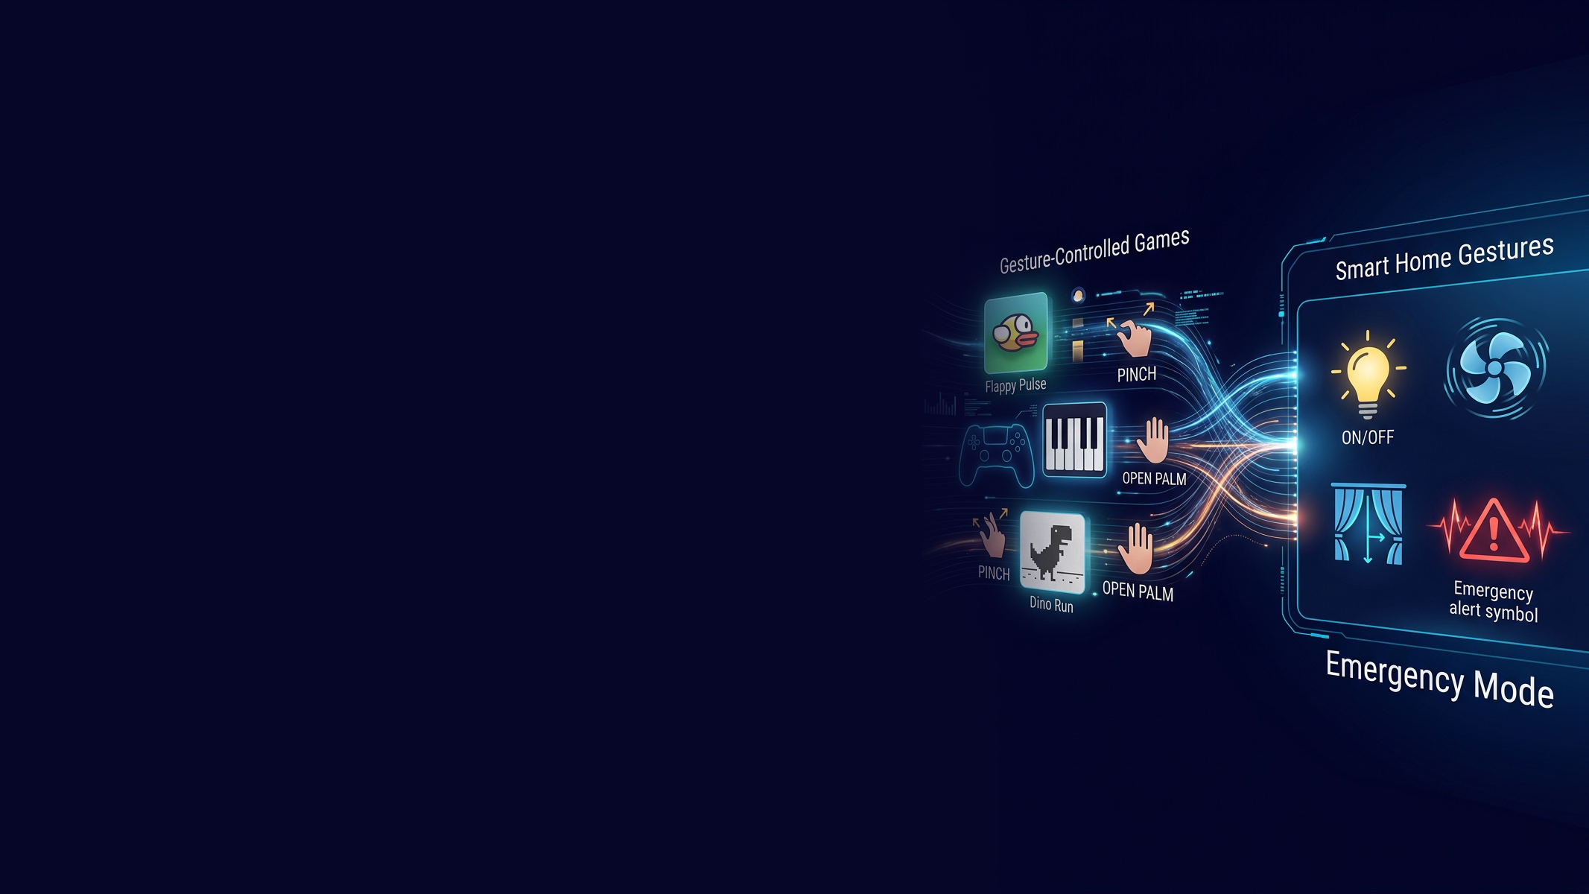

GESTURE CONTROL SYSTEM
A Computer Vision Based Approach to Human-Computer
Interaction
Bholasankar Sethi | Roll No. 24MCA006
Sai Yangyadatta Sethy | Roll No. 24MCA030
Sanjib Sahu | Roll No. 24MCA032
Guide: Mr. Biswojit Nayak
MCA Final Year Project

Slide 2
INTRODUCTION — Project Definition
A real-time hand gesture recognition system enabling touchless computer control using a standard webcam — no specialized hardware required.
TECHNOLOGY MODULES
KEY ALGORITHMS
Hand Tracking
MediaPipe Hands — 21 landmarks
Weighted Moving Average
Image Processing
OpenCV frame capture & preprocessing
Cursor smoothing to reduce jitter by 65%
Gesture Classification
Rule-based decision tree + finger state
Real-time Comm.
WebSocket + Socket.IO
Euclidean Distance
Backend
Flask (Python)
Pinch detection using thumb-index distance < 30px
Frontend
Tailwind CSS + JavaScript
Database
SQLite (local) / MongoDB (cloud)
Template Matching
System Automation
PyAutoGUI
Stroke recognition for Air Keyboard input
Architecture: Multi-tier Full-Stack with multi-modal feedback

Slide 3
INTRODUCTION — Scope & Objectives
SCOPE OF WORK
OBJECTIVES
Accessibility
Real-time hand landmark detection at 30+ FPS
Recognize 10+ gestures with >85% accuracy
Map gestures to system actions (cursor, click, scroll, zoom)
Build WebSocket client-server architecture
Web dashboard for analytics and device management
Auxiliary apps: Air Canvas, Air Keyboard, Games
Multi-modal feedback (sound, voice, haptics)
Touchless control for physically disabled users
Medical
Sterile navigation in operating rooms
Education
Interactive, gesture-based presentations
Smart Home
Control lights, fans, curtains via gestures
Entertainment
Gesture-controlled games

Slide 4
LITERATURE REVIEW — Existing Systems
System | Technology | Accuracy | Limitations
Leap Motion (2013) | IR Cameras | 95% | Proprietary hardware ($100), discontinued
Intel RealSense | Depth Sensing | 93% | Expensive ($150–$300), complex SDK
Microsoft Kinect | Structured Light | 85% | Discontinued, full-body only
OpenCV Skin Detection | Color Segmentation | 30–50% | Fails in varied lighting conditions
MediaPipe Hands | ML (CNN) | 90% | No built-in gesture classification
PyAutoGUI + OpenCV | Contour Detection | <40% | Cannot handle complex backgrounds
KEY FINDINGS
▸ High accuracy requires specialized hardware or complex ML models
▸ No unified framework with production-ready features
▸ Software-only solutions lack precision for practical use
▸ Accessibility features (voice/haptic feedback) rarely considered

Slide 5
RESEARCH GAP — Identifying the Opportunity
Hardware solutions offer high accuracy but prohibitive costs ($100–$300+), while software-only solutions lack precision for practical, real-world applications.
Cheap Software
Our System
Expensive Hardware
Affordable underlying code and logic
→ Low accuracy
→ Fails in varied lighting
Bridges both worlds:
→ Standard webcam only
→ 85–95% accuracy
→ Production-ready & accessible
High accuracy systems
→ $100–$300+ cost
→ Proprietary / discontinued
KEY OPPORTUNITY
✔ Affordable: Standard webcam — no specialized hardware required
✔ Accurate: 85–95% accuracy across 11 gestures
✔ Production-Ready: Full-stack with analytics and device management
✔ Accessible: Voice feedback, haptic support, multi-device synchronization

Slide 6
PROBLEM STATEMENT — Core Challenges
Hardware Dependency
Accuracy vs. Cost Trade-off
High-accuracy systems need expensive proprietary hardware (Leap Motion $100+, Kinect $150+), limiting accessibility.
Software-only solutions fail in varied lighting, complex backgrounds, and multi-hand scenarios.
Latency & Responsiveness
Lack of Unified Framework
Real-time control requires <50ms end-to-end latency for natural, responsive interaction.
No solution combines cursor control, Air Canvas, Air Keyboard, games, voice feedback, and web analytics.
Accessibility Gap
Most systems ignore multi-modal feedback (voice, haptic) needed by users with disabilities.
Proposed: Software-only, webcam-based system — MediaPipe + WebSocket + multi-modal feedback — 85%+ accuracy at 30+ FPS

Slide 7
PROBLEM STATEMENT FORMULATION
High accuracy gesture recognition systems require expensive proprietary hardware, while software-only solutions lack sufficient precision for practical use. There is no accessible, production-ready platform that combines high accuracy, comprehensive gesture vocabulary, real-time analytics, and accessibility features using only a standard webcam.
SPECIFIC PROBLEMS ADDRESSED
01
Users with disabilities cannot effectively use traditional input devices
02
Public and shared computers pose hygiene risks due to touch surfaces
03
Medical environments require sterile, touchless interaction methods
04
Existing solutions are either costly (hardware) or inaccurate (software)
05
No unified framework exists for gesture logging and analytics

Slide 8
PROPOSED SYSTEM — Three-Tier Architecture
A robust three-tier architecture ensures scalability, security, and real-time performance.
PRESENTATION TIER
APPLICATION TIER
DATA TIER
Python Gesture Client (webcam & landmarks)
Web Dashboard (HTML / CSS / JavaScript)
Real-time gesture visualization overlay
Flask + Socket.IO server
JWT + bcrypt authentication
Device management & REST APIs
WebSocket event handling
MongoDB — Users, Devices, Sessions
Gesture Logs & Scores
SQLite (local), MongoDB (cloud)
KEY INNOVATIONS
Weighted Moving Average
65% jitter reduction, <50ms latency
Dual-mode Recognition
CNN + template matching (Air Keyboard)
Gesture-based Games
Full gesture integration (Flappy, Piano, etc.)
Accessibility Layer
Voice (Speech Synthesis) + Haptic (Vibration API)

Slide 9
WORKFLOW PIPELINE — Real-Time Processing Flow
End-to-end gesture recognition pipeline — processes each frame in under 33ms for real-time interaction.
01
Webcam Input
02
MediaPipe Detection
03
Landmark Extraction
Real-time video capture at 30+ FPS via OpenCV
Hand detection and bounding box calculation
21 hand landmarks extracted per frame
04
Gesture Classification
05
Action Execution
06
WebSocket Sync
Rule-based decision tree analyzes finger states
PyAutoGUI executes mapped system commands
Dashboard updates via Socket.IO in real-time

Slide 10
TECHNOLOGY STACK — Complete Implementation
Computer Vision
Backend Server
OpenCV + MediaPipe
Flask + Socket.IO
Frontend Dashboard
Database
HTML + Tailwind CSS + JavaScript
MongoDB (cloud) + SQLite (local)
System Automation
Communication
PyAutoGUI
WebSocket Protocol
Programming Language
Python
Stack selected for reliability, performance, and open-source availability

Slide 11
IMPLEMENTATION — Core Gesture Control (Features 1–2)
FEATURE 1: Core Gesture Recognition
FEATURE 2: Cursor Smoothing
Gesture | Action | Accuracy | Latency
POINT | Move cursor | 92% | <45ms
PINCH | Left click | 95% | <40ms
PEACE | Right click | 87% | <45ms
THREE | Scroll | 82% | <50ms
ZOOM | Zoom In/Out | 90% | <50ms
FIST | Disable control | 91% | <40ms
PALM | Enable control | 88% | <40ms
PALM_HOLD (4s) | Screenshot | 85% | —
Input:
Raw cursor positions (x, y)
Process:
Weighted Moving Average (window = 5)
Output:
Smoothed cursor position
Jitter Reduction:
65% improvement
WMA Formula:
Σ(wᵢ × posᵢ) / Σ(wᵢ)
where weights decay with age of sample

Slide 12
IMPLEMENTATION — Air Canvas & Air Keyboard (Features 3–4)
FEATURE 3: Air Canvas — Touchless Drawing
FEATURE 4: Air Keyboard — Gesture Typing
Finger | Color | Use
Index | Red | Primary drawing
Middle | Blue | Secondary drawing
Ring | Green | Highlight
Pinky | Yellow | Fine details
Thumb | Purple | Erase
1. Stroke Capture
2. Normalize (64×64)
3. Skeletonize
4. Template Matching
Additional capabilities:
5. Word Prediction
Adjustable brush size and color palette
Trajectory smoothing using WMA algorithm
Clear canvas gesture (FIST hold)
Special gestures:
Swipe Right → Space
Swipe Left → Backspace
Swipe Down → New Line

Slide 13
IMPLEMENTATION — Web Dashboard & Gesture Games (Features 5–6)
FEATURE 5: Web Dashboard
FEATURE 6: Gesture-Controlled Games
Component | Functionality
Active Tracking | Real-time gesture display + confidence meter
Analytics | Gesture count, accuracy, session timer, speed rating
Device Management | Register, edit, delete devices (online/offline status)
User Profile | Customizable preferences (hand, sensitivity, theme)
Data Export | CSV/JSON export, session recording & replay
Flappy Pulse
Easy
PINCH to flap
Gesture Piano
Medium
Point + PINCH to play
Dino Runner
Easy
OPEN PALM to jump
Space Shooter
Hard
Point to aim, PINCH to shoot

Slide 14
IMPLEMENTATION — UX Enhancements & Controllers (Features 7–8)
FEATURE 7: Multi-Modal UX Feedback
FEATURE 8: Smart Home & Presentation
Sound
Auditory confirmation of gestures
Smart Home Gestures:
Web Audio API
POINT UP → Lights ON
POINT DOWN → Lights OFF
PEACE → Fan ON
FIST → Fan OFF
OPEN PALM (Wave) → Curtains
OPEN PALM (Hold 3s) → Emergency Mode
Voice
Accessibility for visually impaired
Speech Synthesis
Haptic
Tactile feedback on mobile
Vibration API
Presentation Controller Gestures:
POINT → Next Slide
PEACE → Previous Slide
PINCH IN/OUT → Zoom
OPEN PALM → Fullscreen
Visual
Real-time gesture visualization
Canvas Overlay

Slide 15
RESULT ANALYSIS — Accuracy Testing (100 tests per gesture)
92%
87.4%
30+ FPS
<50ms
Best Accuracy
(POINT)
Average
Accuracy
Frame Rate
Maintained
End-to-End
Latency
Gesture | Success | Failure | Accuracy
POINT | 92 | 8 | 92%
PINCH | 95 | 5 | 95%
PEACE | 87 | 13 | 87%
THREE | 82 | 18 | 82%
FIST | 91 | 9 | 91%
PALM | 88 | 12 | 88%
User Acceptance Testing (n=10)
Ease of Use
4.2 / 5
Recognition Speed
4.5 / 5
Accuracy Satisfaction
4.0 / 5
Dashboard Clarity
4.8 / 5
Overall Satisfaction
4.3 / 5
All gesture features exceeded the 80% accuracy threshold, validating the rule-based classification approach.

Slide 16
RESULT ANALYSIS — Performance Metrics
Metric | Target | Achieved | Status
Gesture Recognition Latency | <50ms | 35–45ms | ✅ PASS
WebSocket Propagation | <20ms | 10–15ms | ✅ PASS
Camera FPS | 30 FPS | 28–30 FPS | ✅ PASS
CPU Usage | <20% | 10–15% | ✅ PASS
Memory Usage | <200MB | 150MB | ✅ PASS
Concurrent Users | 100+ | Simulated 100 | ✅ PASS
All 6 Performance Targets
Average System Accuracy
Air Keyboard (min accuracy)
ACHIEVED
87.4%
81%

Slide 17
CONCLUSION & IMPACT
CONCLUSION
IMPACT
Successfully implemented real-time hand gesture recognition using MediaPipe
💰 Cost Reduction
100% hardware cost saved using standard webcam
Achieved 85–95% accuracy across 11 gestures with <50ms end-to-end latency
Built a production-ready client-server architecture with WebSocket synchronization
♿ Accessibility
Touchless interaction for disabled and medical users
Developed auxiliary applications: Air Canvas, Air Keyboard, and Games
Integrated multi-modal feedback: sound, voice, and haptic systems
🏠 Smart Home
Foundation for gesture-based home automation
Created a responsive web dashboard with analytics and device management

Slide 18
FUTURE IMPROVEMENTS & ROADMAP
01
Gesture Precision
02
Low-End Device Optimization
03
UI/UX Enhancement
Improve tracking stability and reduce false positives in complex backgrounds
Optimize processing pipeline for slower hardware without sacrificing FPS
Redesigned dashboard with enhanced accessibility features and dark mode
04
Smart Device Integration
05
ML-Based Classification
06
Real-World Scalability
Expand to control IoT devices, TVs, and smart home hubs via API
Replace rule-based engine with CNN model for higher accuracy
Multi-user deployment testing and cloud-native WebSocket architecture

Slide 19
REFERENCES
1
Google MediaPipe. "Hand Landmarker Guide." Google Developers, 2024.
2
Lugaresi, Camillo, et al. "MediaPipe: A Framework for Building Perception Pipelines." arXiv:1906.08172, 2019.
3
Zhang, Fan, et al. "MediaPipe Hands: On-device Real-time Hand Tracking." arXiv:2006.10214, 2020.
4
Bradski, Gary, and Adrian Kaehler. Learning OpenCV: Computer Vision with the OpenCV Library. O'Reilly Media, 2008.
5
Grinberg, Miguel. Flask Web Development: Developing Web Applications with Python. 2nd ed., O'Reilly Media, 2018.

Slide 20
LIVE DEMO — Demonstration Sequence
Planned sequence showcasing key functionalities of the gesture control system
1. Server Startup
2. Login
3. Gesture Client
4. Cursor Control
Show terminal with WebSocket ready
admin/admin123 → Dashboard
Run gesture_client.py --offline
Index finger movement tracking
5. Click
6. Scroll
7. Zoom
8. Screenshot
Pinch gesture detection
Three-finger vertical movement
Three-finger pinch ratio
Open palm hold for 4 seconds
9. Air Canvas
10. Air Keyboard
11. Games
12. Smart Home
Draw using different fingers
Write letters, show word prediction
Play Flappy Pulse with PINCH
Point UP/DOWN, Peace, Fist, Emergency
13. Analytics
All features will be demonstrated live with the webcam-based gesture client
Dashboard updates in real-time

Slide 21
THANK YOU
Gesture Control System — MCA Final Year Project
Questions & Discussion Welcome
Bholasankar Sethi
Sai Yangyadatta Sethy
Sanjib Sahu
Guide: Mr. Bijswojit Nayak

